Slide 1
GRUDGE

Slide 2
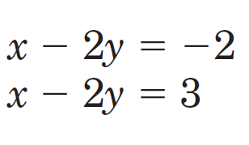
Solve the system by graphing.

Slide 3
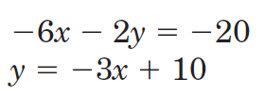
Solve the system using substitution.

Slide 4
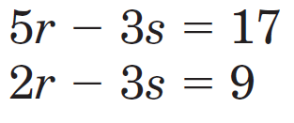
Solve the system using elimination:

Slide 5
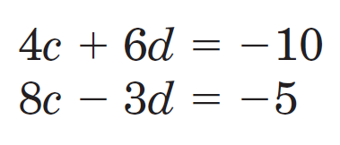
Solve the system using elimination:

Slide 6
You buy 6 videos on sale. The videos are on sale for $8 and $10. You spend $52. How many $8 videos did you buy? Write a system of equations & solve.

Slide 7
The senior classes at Westlake High School and T.O. High School planned separate trips to New York City. The senior class at WHS rented and filled 4 vans and 12 buses with 780 students. Each van and each bus carried the same number of students. How many students can a van carry? Write a system of equations & solve.

Slide 8
The senior classes at Westlake High School and T.O. High School planned separate trips to New York City. The senior class at WHS rented and filled 4 vans and 12 buses with 780 students. Each van and each bus carried the same number of students. How many students can a bus carry? Write a system of equations & solve.

Slide 9
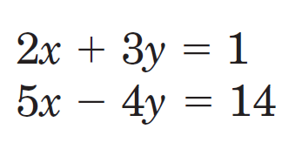
Solve with any method

Slide 10
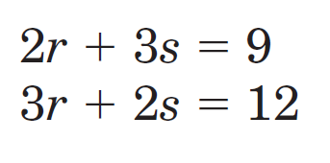
Solve with any method

Slide 11
A boat traveled 210 miles downstream and back. The trip downstream took 10 hours. The trip back took 70 hours. What is the speed of the boat in still water?

