Slide 1
Dream Job

Slide 2
Part 1 – The Situation
The Situation:
You are offered a trial period at your dream job. However, your boss is a little unusual so the pay options are non-traditional. They offer you three different pay options:
Option 1: $60,000 a day
Option 2: You make one penny the first day, two pennies the second day, four pennies the third day, eight pennies the fourth day, etc.
Option 3: On your first day of work, you get $1. On your second day of work, you get $4. On your third day of work, you get $9. It continues this way for 30 days and then once you’ve completed the job you receive a completion bonus of $500,000.

Slide 3
Part 1 – The Situation
$60,000 a day
You make one penny the first day, two pennies the second day, four pennies the third day, eight pennies the fourth day, etc.
On your first day of work, you get $1. On your second day of work, you get $4. On your third day of work, you get $9. It continues this way for 30 days and then once you’ve completed the 30 days you receive a completion bonus of $500,000.
Decide how you can calculate the earnings of each option by using an unknown amount of days “x”. You must use at least two representations (tables, graphs, and/or equations) for each option.

Slide 4
Part 2:
Your boss finally called and confirmed that this trial period will be 30 days.
Decide which option is best.
Explain with algebra and in writing why your option is the best.

Slide 5
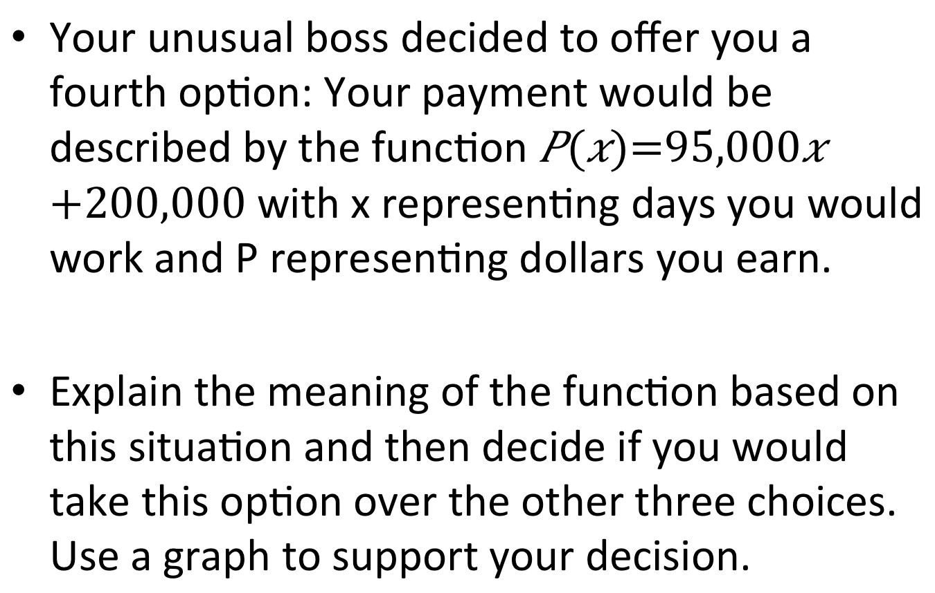
Part 3 – A Fourth Option
Your unusual boss decided to offer you a fourth option: Your payment would be described by the function with x representing days you would work and P representing dollars you earn.
Explain the meaning of the function based on this situation and then decide if you would take this option over the other three choices. Use a graph to support your decision.

